Slide 1
Does Forest Growth Correlate to Happiness?
By Taimoor Arshad
Charlene Gray
Sathya Kulatunga
Nida Hussain

Slide 2
Our Question
We wanted to answer the question: does the environment have a strong correlation to happiness and/or economic growth?
Does forest growth or the presence of any greenery have a tangible and measurable effect on it’s populace?
Is it measureable?
How can we measure this?

Slide 3
“Correlation Does Not Always Mean Causation”
The correlation between forest and the social well being of a populace is complex and multilayered.
For example does the presence of greenery affect the level of oxygen and therefore make people think clearer? If this were true, would it really translate to economic growth? Or would the effects be different for each person and thus be nearly impossible to measure?
We hoped to better answer this question by comparing varied social statistics against local forest density in hopes of discerning a consistent pattern.
However, we ultimately wanted a universal index to compare forest density to in order make a clearer comparison.

Slide 4
Defining Happiness
We needed to make a quantitative measure of happiness and economic growth.
Is it salary based, health based, property based, or something else?
We decided to use various social, health, poverty, and crime statistics as measures of “happiness”.

Slide 5
Defining Forest?
Defining what we considered to be forest was a little bit more straightforward.
However, there were some variations as to what was considered “greenery”.
We decided on using the definitions measured by various state and federal agencies as our definitions.
We also found it was important to distinguish between number/amount of “greenery” and the ratio between “greenery” and local population. In essence, having a forest density measure.
In our study we used square meters of tree canopy cover per person.

Slide 6
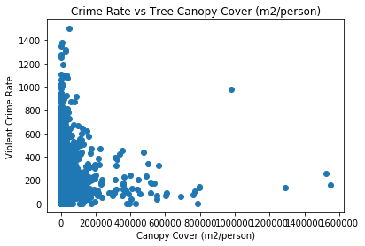
Violent Crime Rate
We can roughly see that there is a negative correlation between Violent Crime Rate and Forest Density

Slide 7
Crime Rates
As with violent crime rates, we see a rough negative correlation.

Slide 8
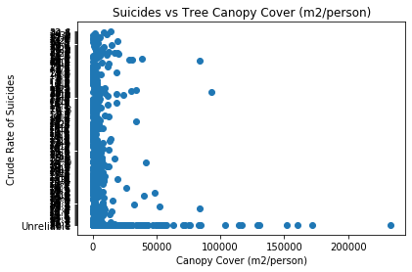
Suicide Rates
Here again, we see a rough negative correlation between Suicide Rates and Forest Density.

Slide 9
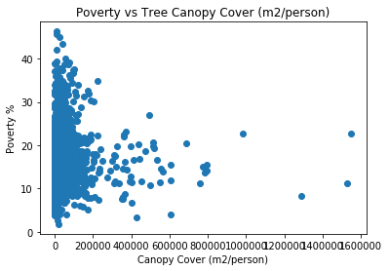
Poverty Rates
Poverty Rates have a negative correlation to Forest Density.

Slide 10
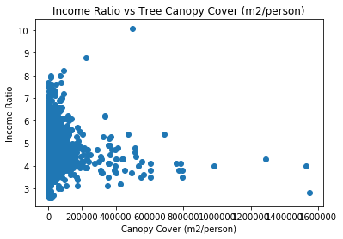
Income Ratio

Slide 11
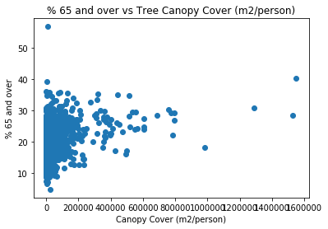
Percentage of Population over 65 years old.

Slide 12
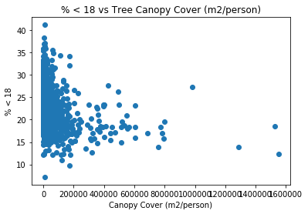
Percentage of Population under 18 years old.

Slide 13
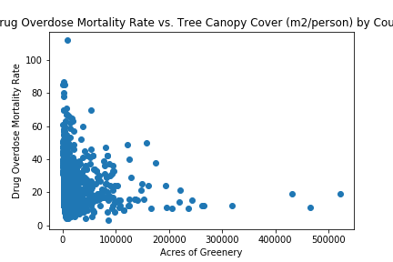
Drug Overdose Mortality Rate

Slide 14
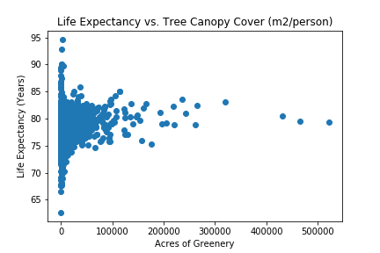
Life Expectancy

Slide 15
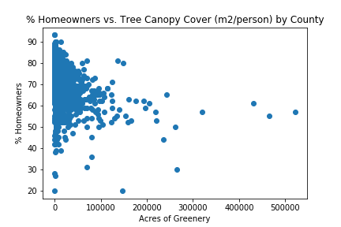
Percentage of Homeowners

Slide 16
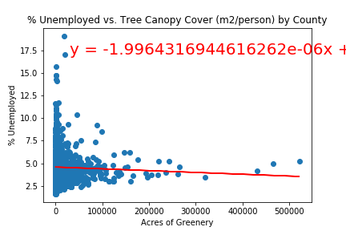
Percent Unemployed

Slide 17
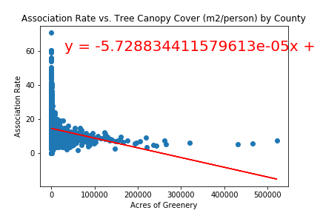
Association Rate (Amount of Community Services/Associations)

Slide 18
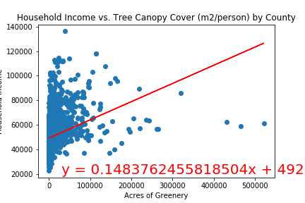
Household Income

Slide 19
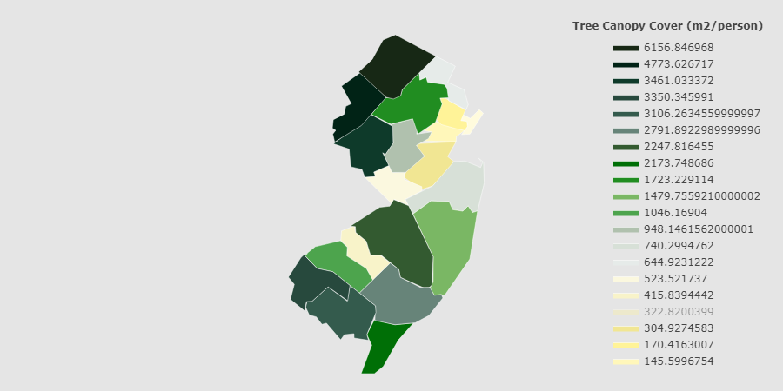
Tree Canopy Cover (m²/person)

Slide 20
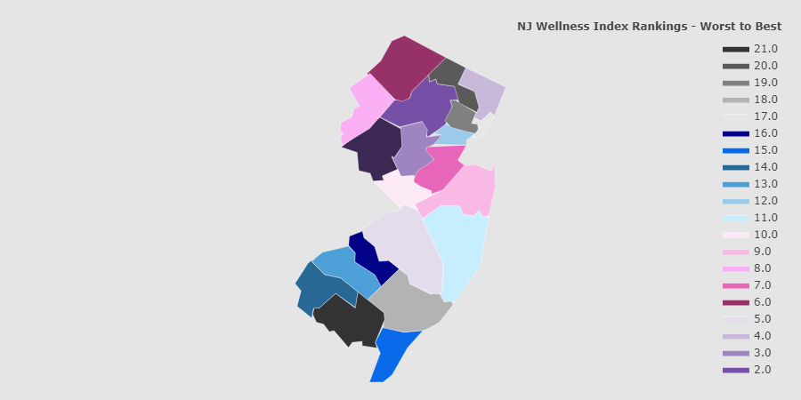
NJ County Wellness Ranking

Slide 21
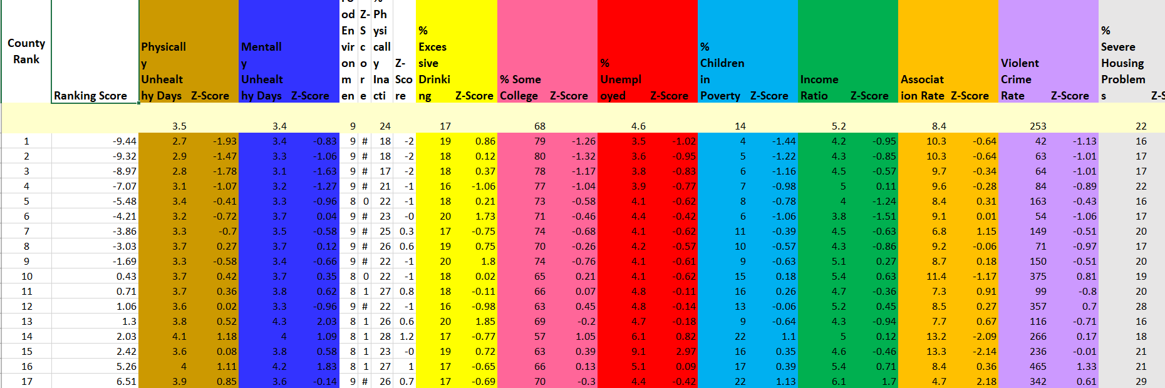
Calculations of Wellness Index

Slide 22
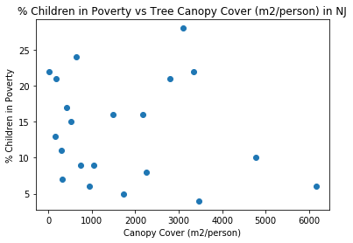
Percent Child Poverty in NJ

Slide 23
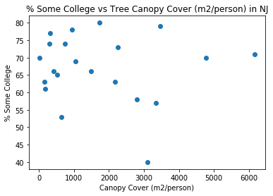
Percent College Education in NJ

Slide 24
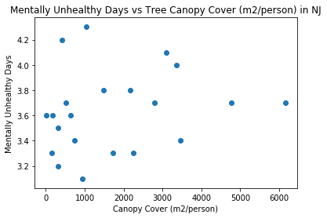
Mentally Unhealthy Days in NJ

Slide 25
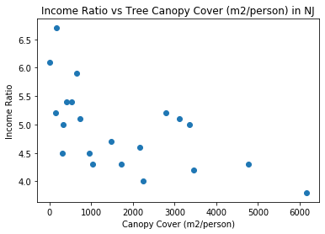
Income Ratio in NJ

Slide 26
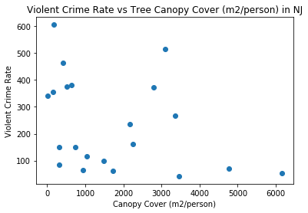
Violent Crime Rate in NJ

Slide 27
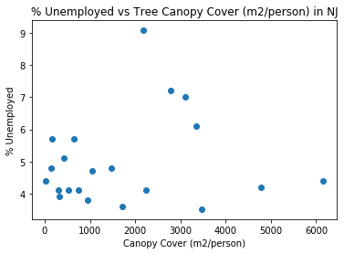
Percent Unemployed

Slide 28
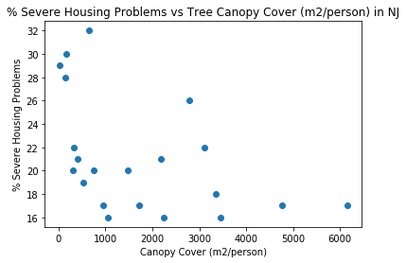
Percent Severe Housing Problems in NJ

Slide 29
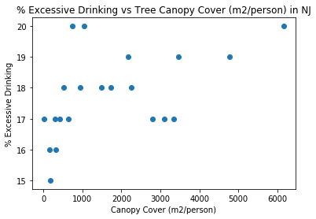
Percent Excessive Drinking in NJ

Slide 30
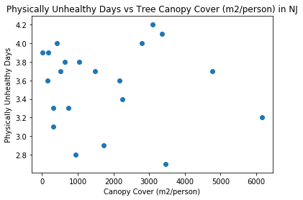
Physically Unhealthy Days in NJ

Slide 31
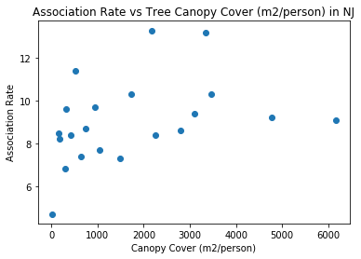
Association Rates in NJ

Slide 32
Afterword
As stated earlier, we believed that the correlation between forest growth and the social states of different states would be complex. As well their interactions may have many layers.
When it comes to national data, we see that there does exist slight correlations both expected and unexpected when plotted against forest growth.
However, when it comes to national data, there may be multiple phenomenon occur within each dataset.

Slide 33
Afterword (Cont.)
Certain extraneous circumstances can exist that vary from state to state which can skew our data.
Politics can have an affect on different metrics such as mental stress, unemployment, etc.
Environmental stressors unique to certain geographic areas of the United States may cause “happiness” to be effected despite forest growth.
A further study may want to look at datasets specific to states or certain contiguous geographic locations that share very similar features.

